Slide 1
Pathfinder Character Creator
By Connor Barnes

Slide 2
Outline
What and why?
The different components that went into creation
Actual code
Demo of the program
Plans for the future

Slide 3
What is Pathfinder?
Tabletop Roleplaying Game
One person acts as the GameMaster
The others create their own characters

Slide 4
Why?
To motivate friends to finally go through with a game
To make something modular that supports future growth
To help streamline a process that could take forever

Slide 5

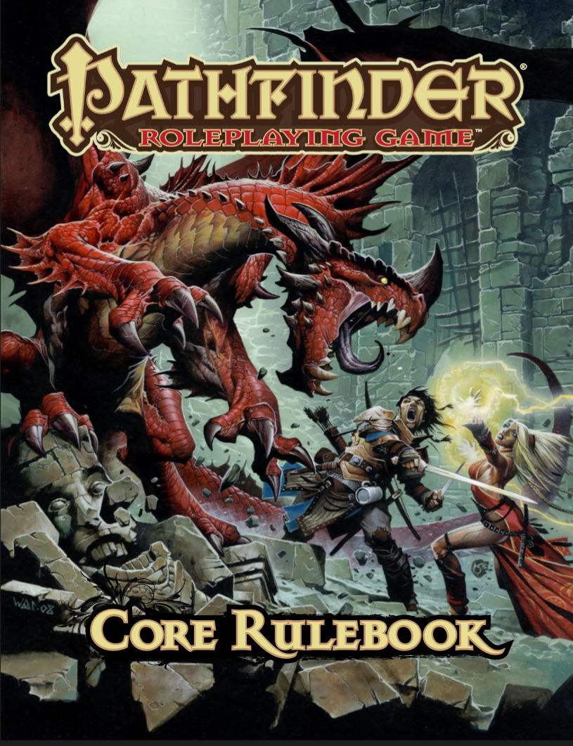



The Setup

Slide 6
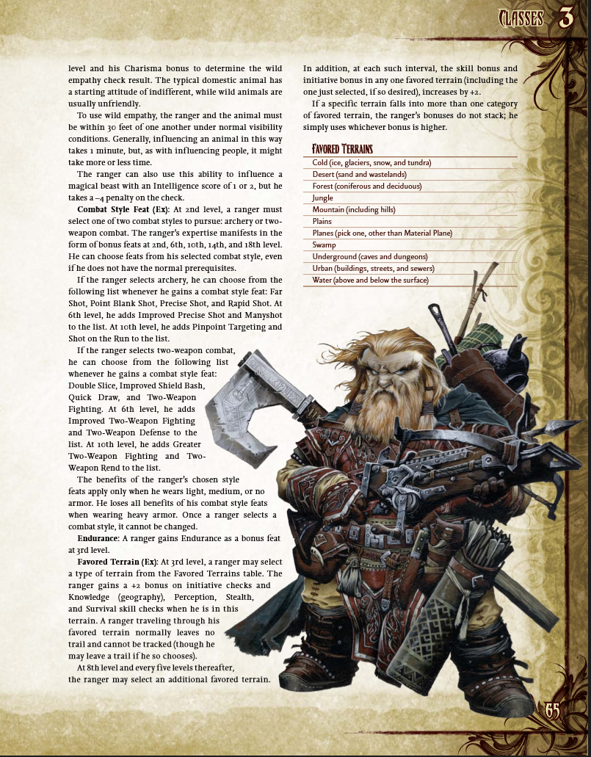
The Book
575 pages
Many tables and illustrations
Segmented into chapters to help character creation process
One of many(inspiration)

Slide 7
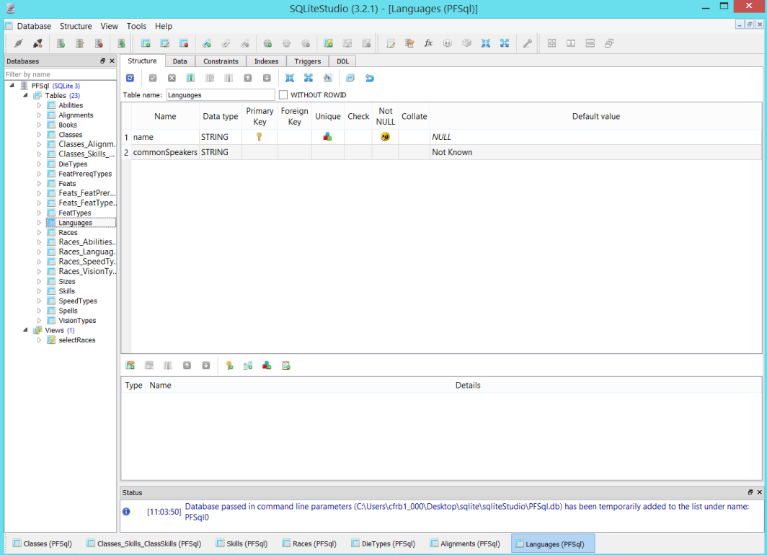
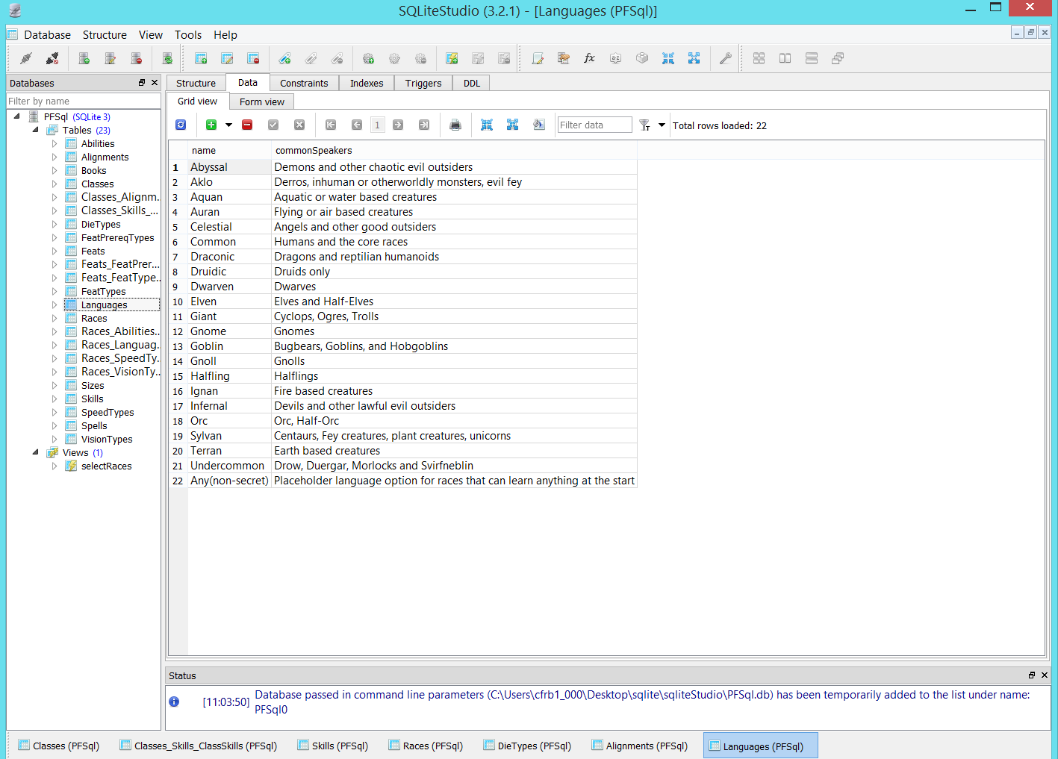
The Database
Sqlite3 with SqliteStudio for GUI

Slide 8
The Programming
Written in Java
Eclipse
JDBC API to connect to the database
Uses JavaFX library to make GUIs
Scene Builder to make JavaFX even easier

Slide 9
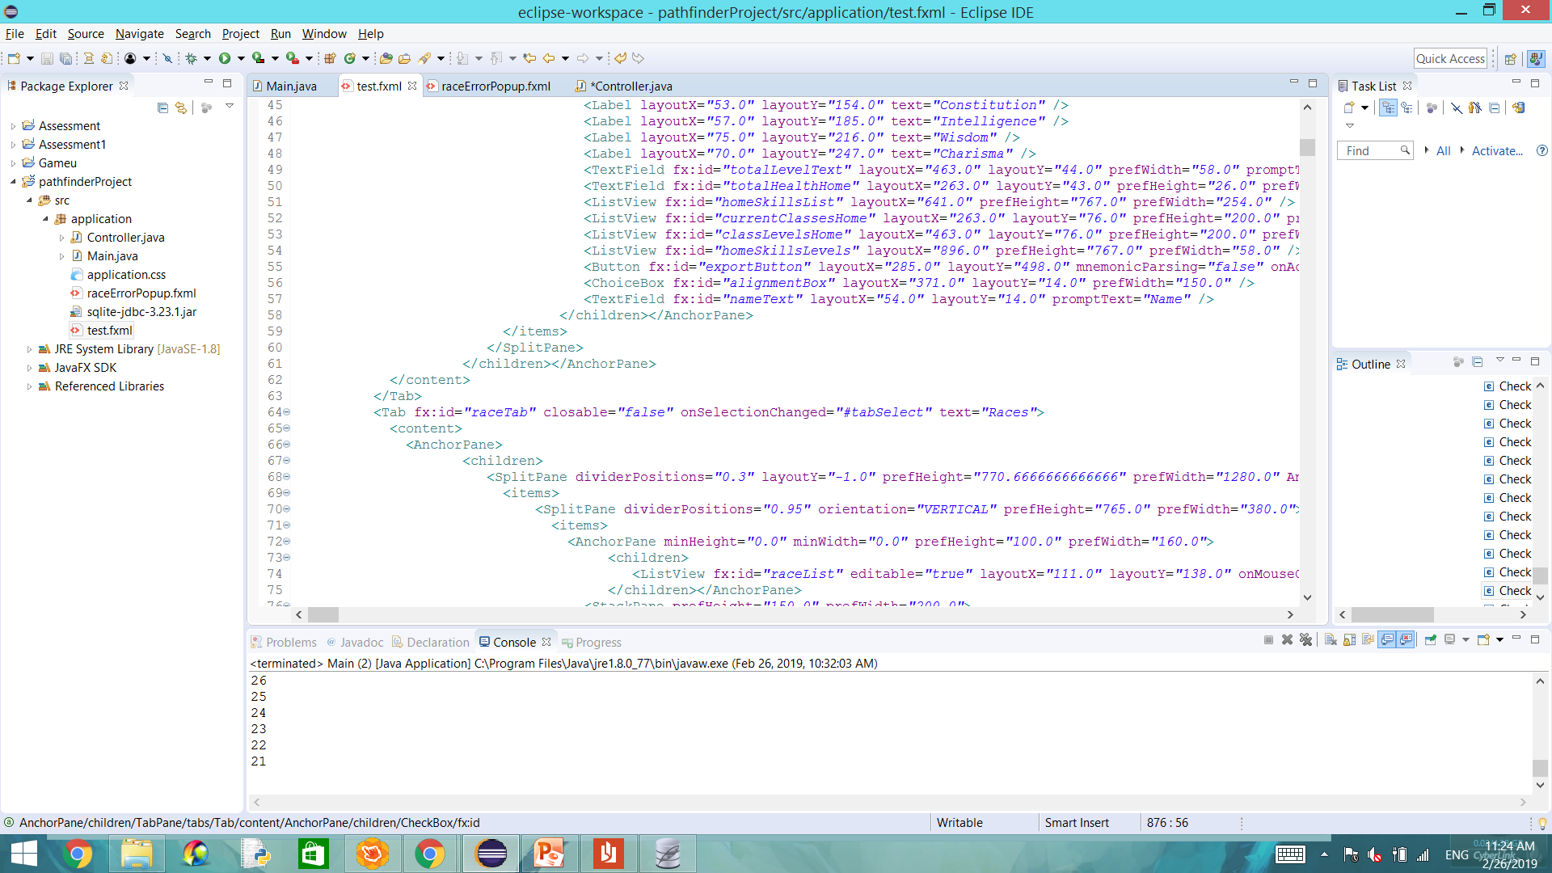

Slide 10
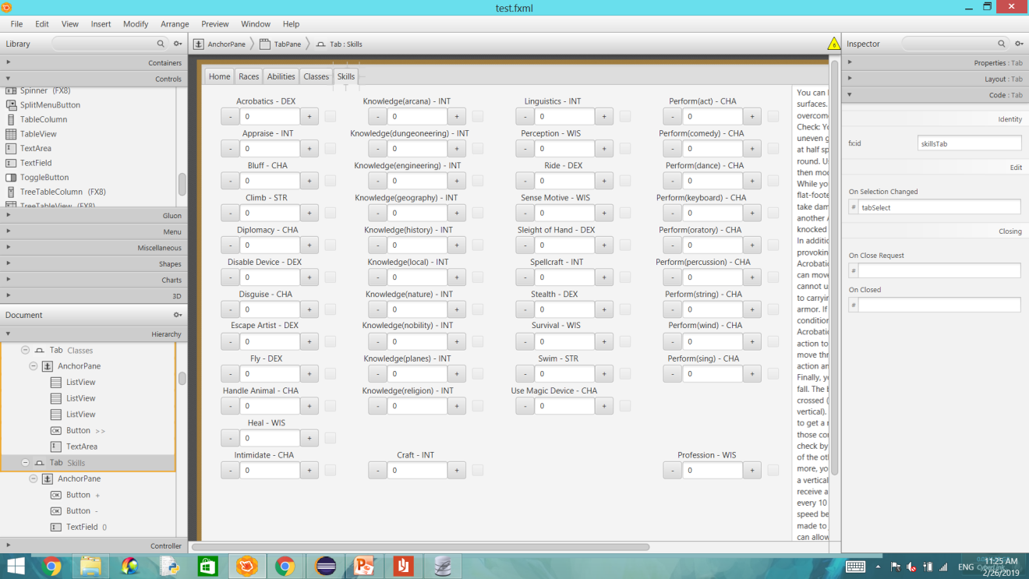

Slide 11
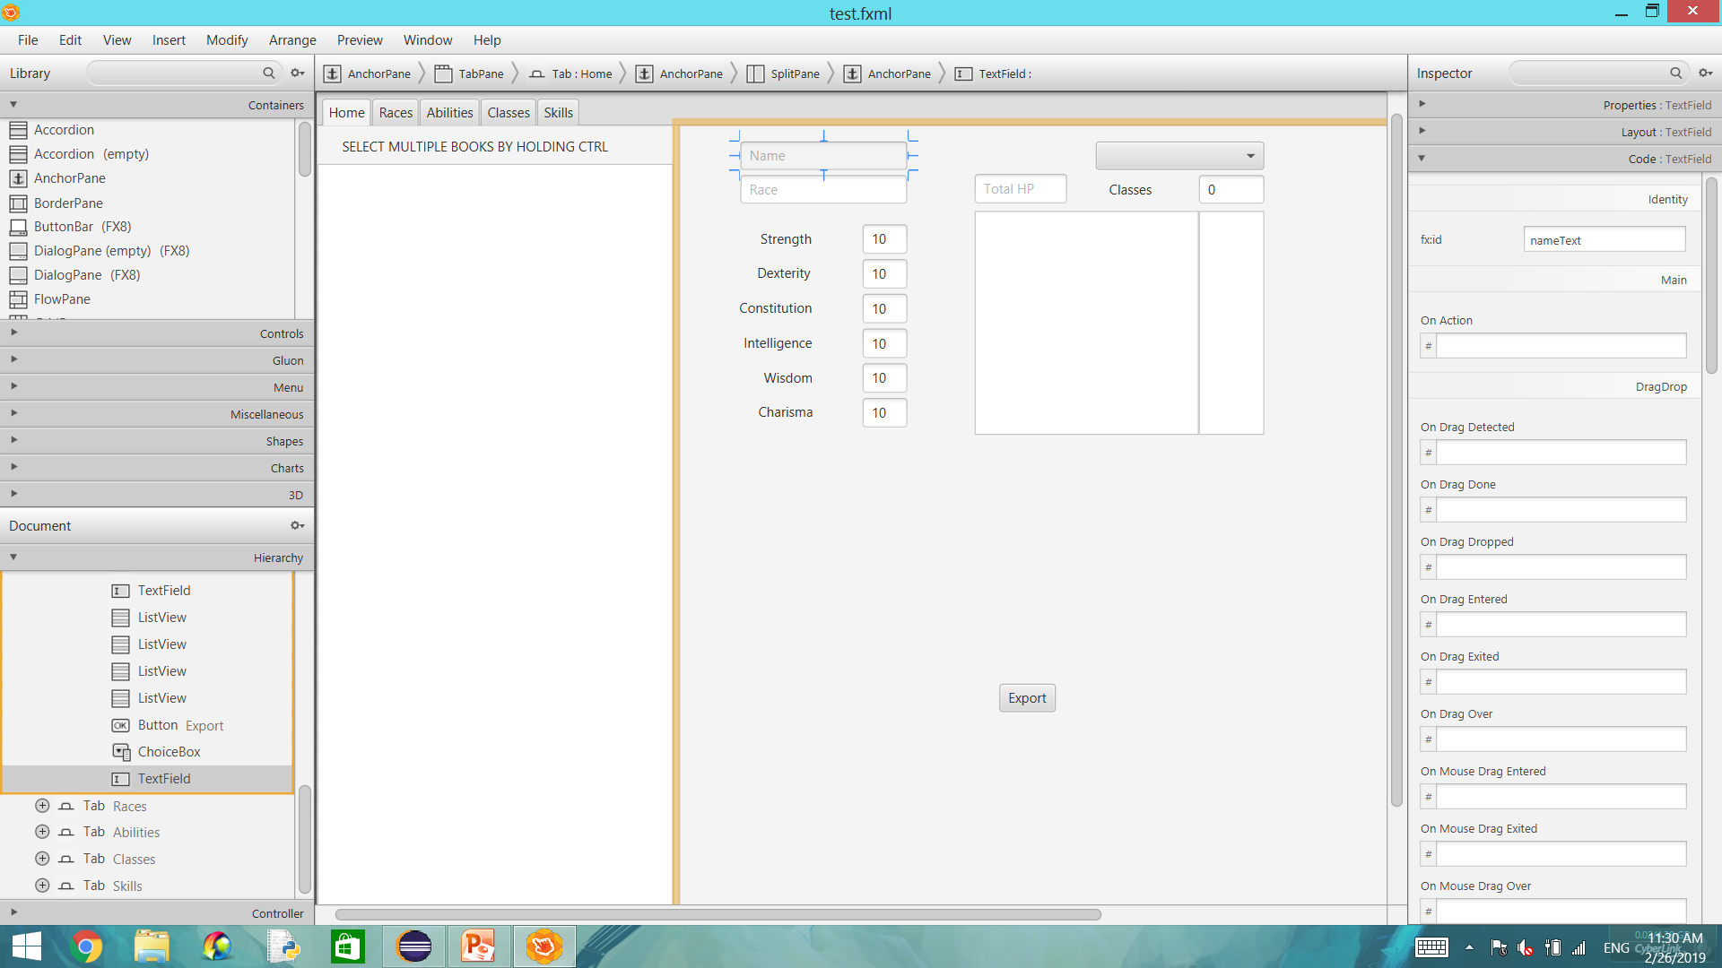
How does it work?
In Scene Builder there is a section that allows you to name an object, as well as many options for method calls based on various circumstances….

Slide 12
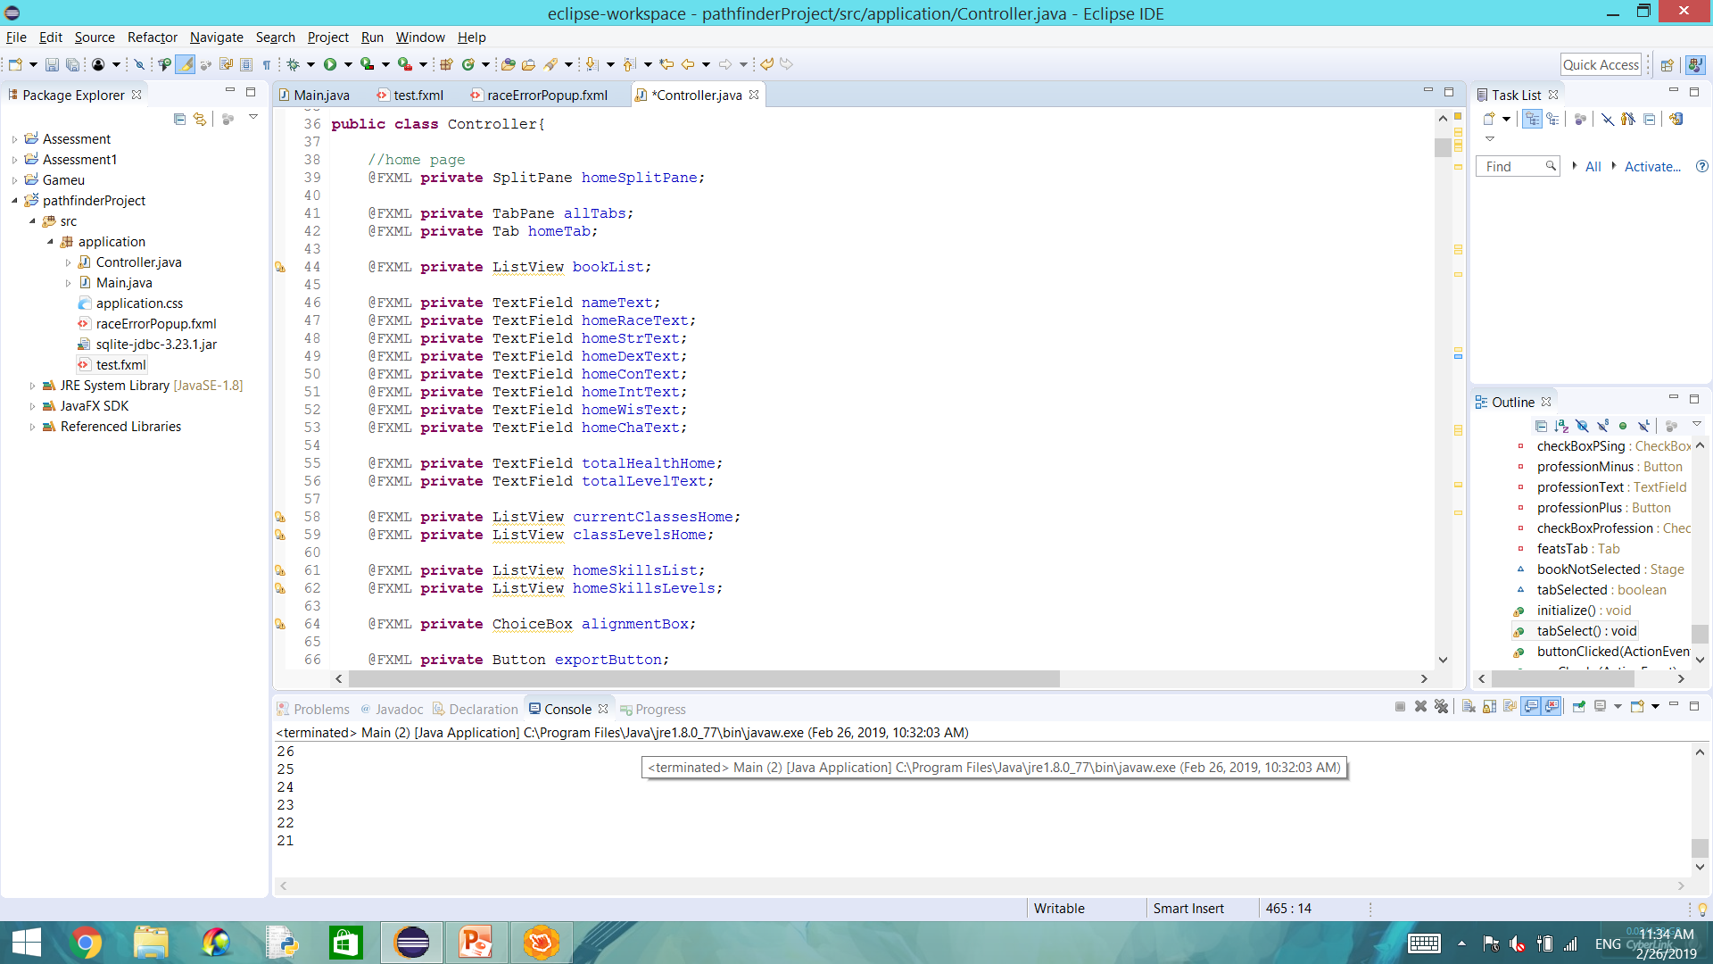
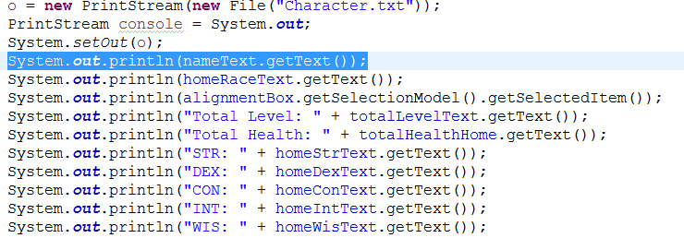
……and once an object is named, in the actual code you must create a private variable with the same name, which then allows you to interact with it in the code.

Slide 13
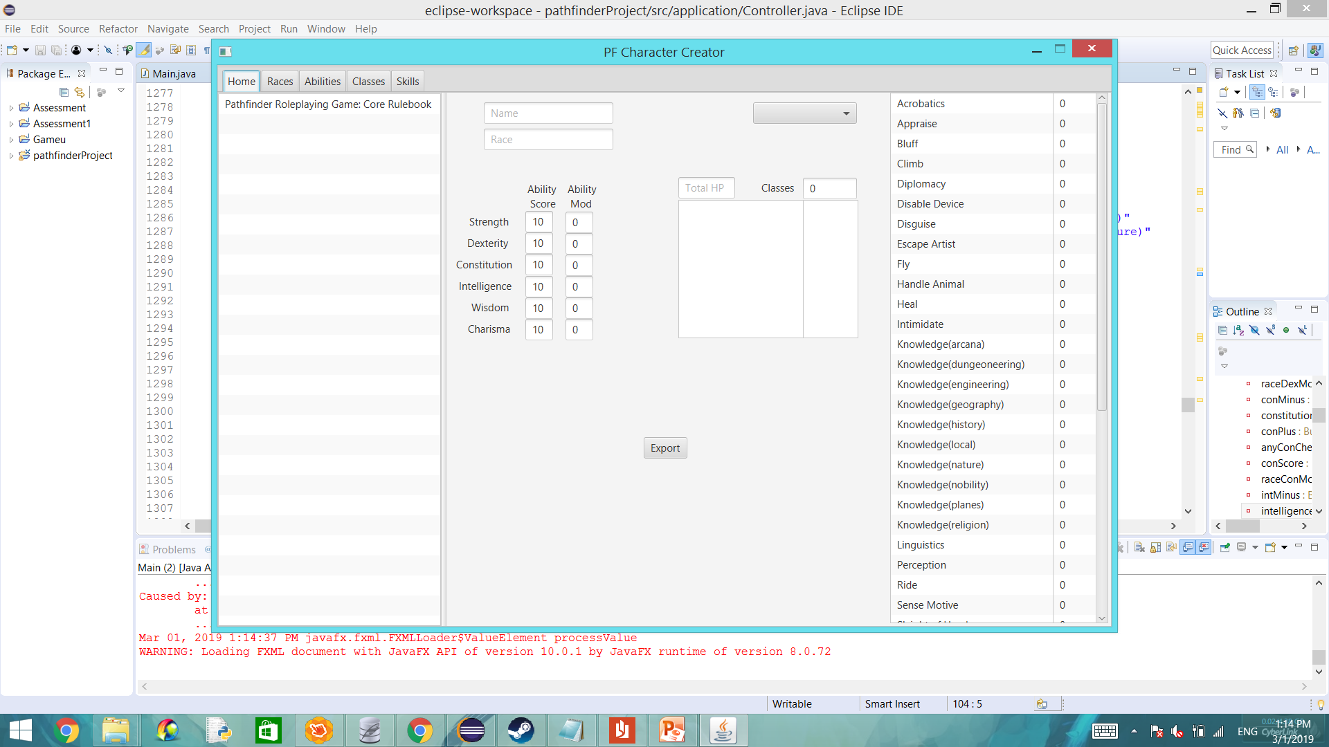
The Code
Segmented based on tabs
Text boxes very helpful

Slide 14
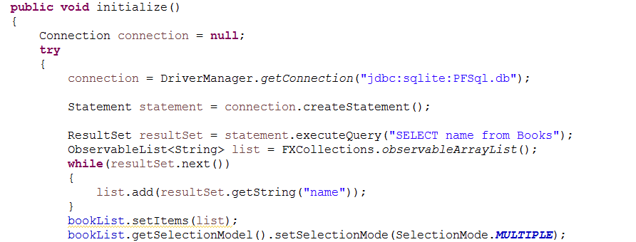
Interactions with database simple
Often used to fill out objects(ListViews, TextFields, etc)
Many states of objects make inter-object interactions easy as well.

Slide 15
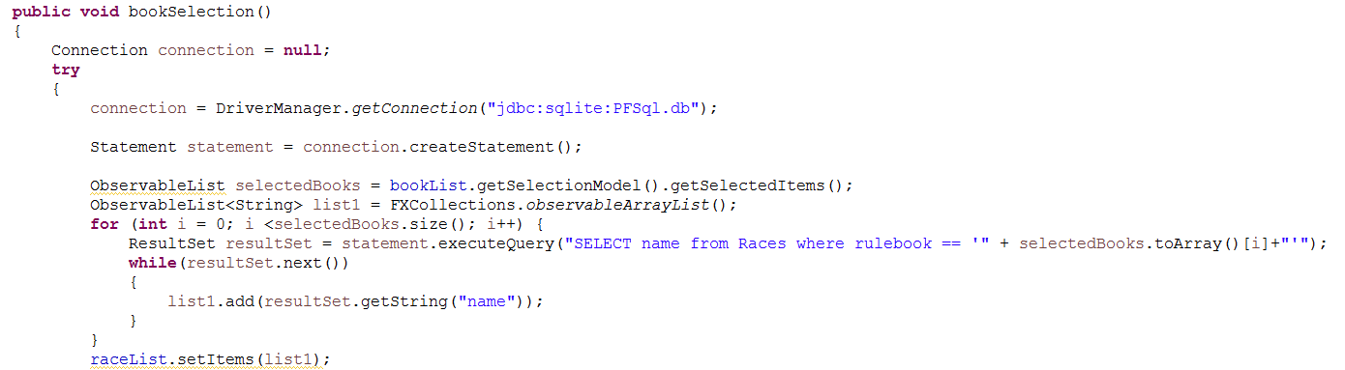
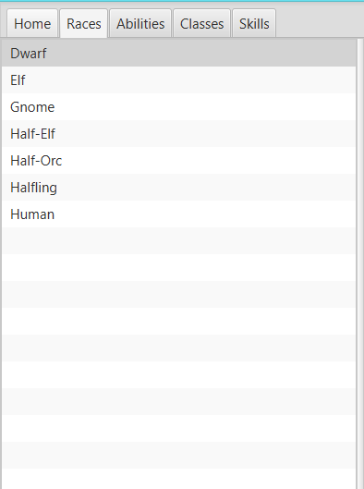
Selecting some objects fills other ListViews properly
Button presses also used in multiple locations

Slide 16
DEMO

Slide 17
What’s in the future?
Craft and Profession Skills
Working Feats List with requirements
Data entry on the hundred pages of spells
Teamwork and inputting more books

Slide 18
Closing Statements
Reasons behind making this project
Programs used to make it work
How they interact in the code
A demo
Plans for the future

Slide 19
Sources
Download SQLite. (n.d.). Retrieved from https://sqlite.org/download.html
Foundation, E. (n.d.). Download Eclipse. Retrieved from https://www.eclipse.org/downloads/
Java SE Downloads. (n.d.). Retrieved from https://www.oracle.com/technetwork/java/javase/downloads/index.html
Jhaeman, & Whitefur, E. (2017, June 16). Paizo.com. Retrieved from https://paizo.com/products/btpy88yj?Pathfinder-Roleplaying-Game-Core-Rulebook
Scene Builder. (n.d.). Retrieved from https://gluonhq.com/products/scene-builder/

